Slide 1
The Impact of Crowds on News Engagement:
A Reddit Case Study
Benjamin D. Horne and Sibel Adali
Rensselaer Polytechnic Institute
NECO 2017

Slide 2
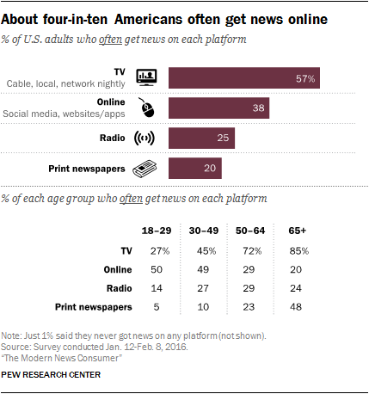

Slide 3
These platforms are built to facilitate engagement, but not necessarily disseminate news.

Slide 4

Reddit is the #4 most visited site in the US, #16 in the World
Curate through selection, voting, and discussing.
Crowds determine what is worthy to read and what is worthy to discuss
Score = Popularity
Commenting = Engagement
Notes:
Take out headine change from here. Introduction the idea of curation

Slide 5
We ask 3 questions:
What news becomes popular through crowd curation?
What news becomes highly engaged through crowd curation?
How does this compare to what we know about traditional news websites?

Slide 6
We extract posts from r/worldnews during 2012 and 2013
Reddit Posts and Comment data set
(Tan and Lee 2015) (Hessel, Tan, and Lee 2016)
Comprehensive data set, almost all posts/comments
Python Goose to scrape news articles posted
Notes:
Not all articles are available

Slide 7
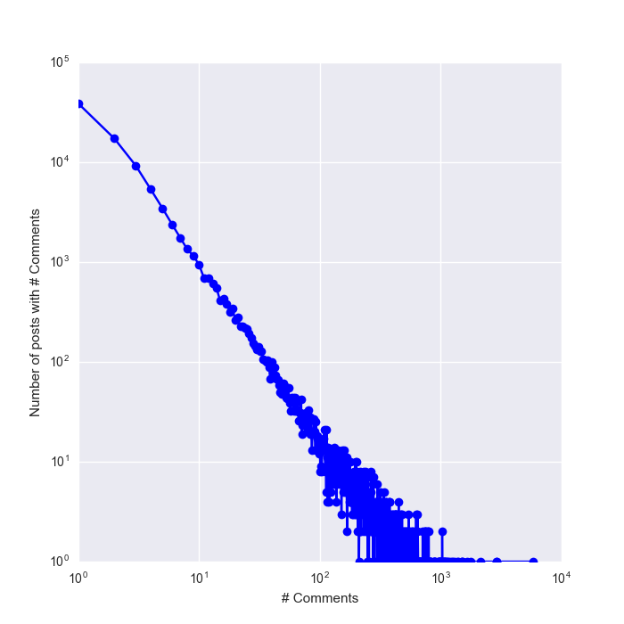
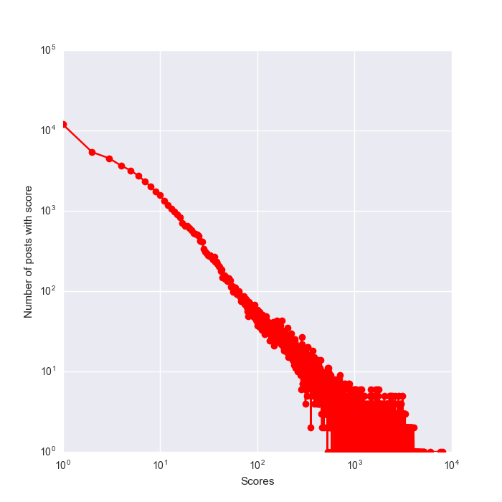
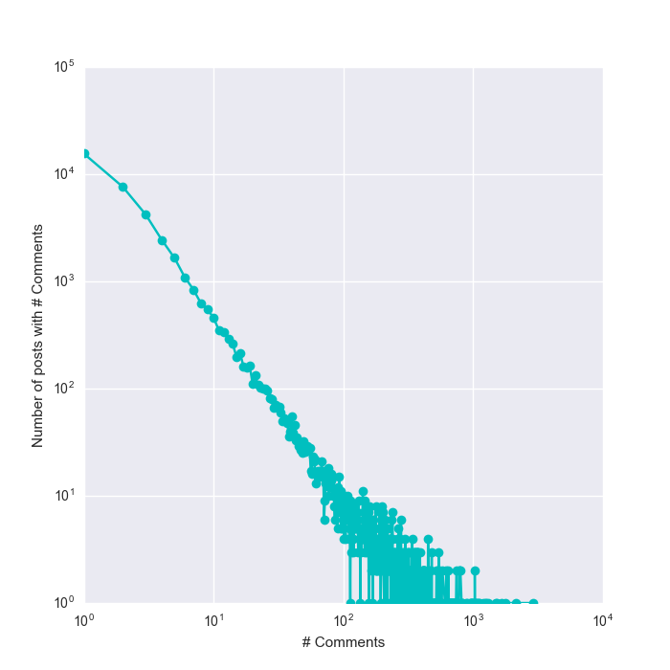
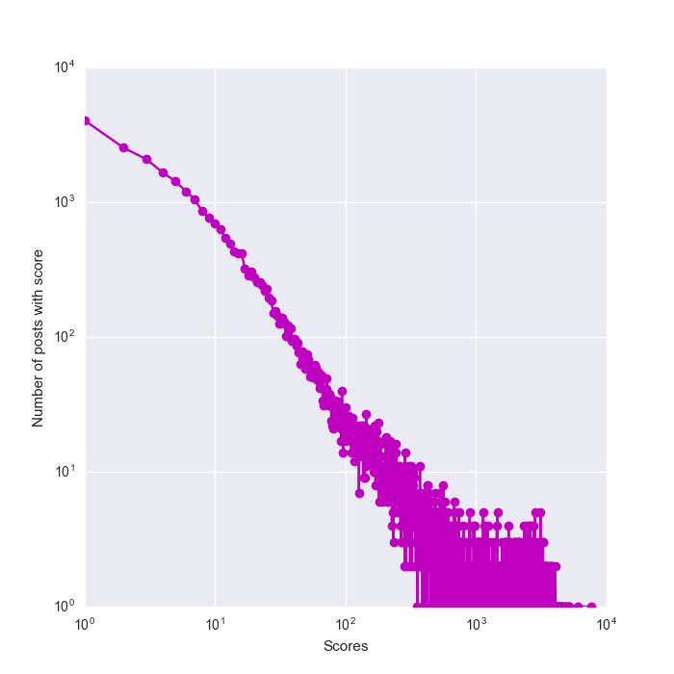
Subreddit | year | # posts | # articles scraped
r/worldnews | 2012 | 60734 | 31938
r/worldnews | 2013 | 93254 | 40809
Total |  | 154K | 72.7K
Scores
Cmts
Original
Scraped
Notes:
Some articles are lost in scraping for several reasons, but you can see we adequately sample the distributions of score and comments

Slide 8
Compute many natural language features on body and title texts
Content | Sentiment/Subjectivity
LIWC Linguistic Features (I, we, pronouns, etc.) | Sentistrength (Reis et al. 2015)
Readability (Keneshloo et al. 2016) | Vader Sentiment (Keneshloo et al. 2016)
Fluency | Subjectivity Classifier
Type-Token Ratio (Lexical Diversity) | LIWC Psychological Features (Analytic, Clout, etc.)
Average word length
# punctuation

Slide 9
Reddit posts are ranked, so we will learn to rank
Rank by Score (Popularity) and # of Comments under the post (Engagement)
Lasso regression with fitting and regularization parameters determined by cross validation
Lasso is a linear model that performs L1 regularization and can handle a large number of correlated features well

Slide 10
LTR Metrics
Original
Predicted
1
2
3
4
5
1
5
K = 2
Precision 50%
KT-dist = 0
Precision @ k: Percentage of top k posts we were able to retrieve correctly.
Kendall-tau distance (KT-distance) @ k: Distance between the relative ranking of the top k posts according to the real score versus the relative ranking by predicted scores

Slide 11
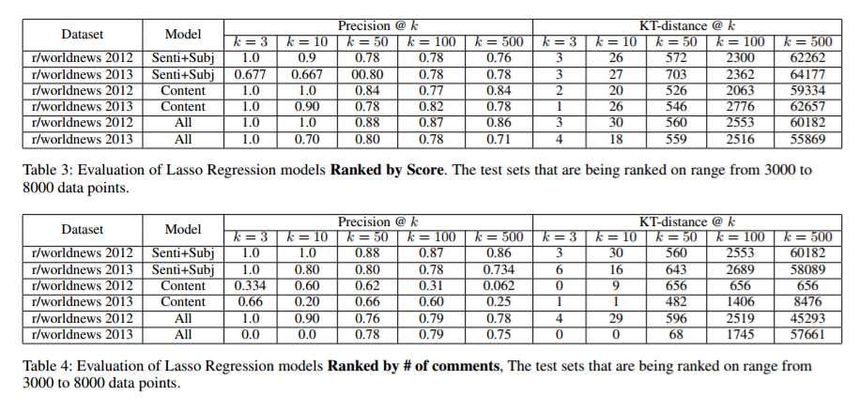
Engagement based on emotion, Popularity based on content
Rank by Popularity (Score)
Rank by Engagement (# of Cmts)
Notes:
Actual label these: popularity and engagement

Slide 12
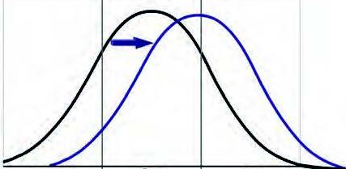
Feature inspection using Wilcoxon Rank-Sum
Hypothesis testing on two class divide on score and # of comments (90th % and 50th %)
Is the difference in group means is due to random variation or the treatment?
Direction of shift informs post-hoc analysis

Slide 13
Many results from previous news popularity studies still hold on reddit
More popular news is:
more negative, more emotional overall
more quotes
more simple words and more easily readable
less subjective
more certain and focuses on the present
more clout and more affiliation
longer
Aligns with (Keneshloo et al. 2016), (Reis et al. 2015) , (Harcup and O’neill 2001),(Lewandowsky et al. 2012)
Notes:
Split what lines up and what is new

Slide 14
Engagement motivated by emotion
More engaged news is:
more negative, but less emotional overall
more insightful
more certain and focuses on the present
less subjective
Content features are not significant in commenting

Slide 15
Headline Changing

Slide 16
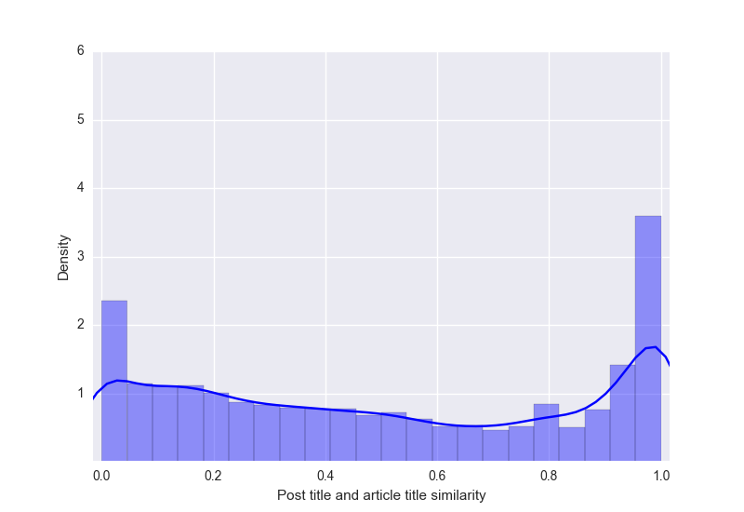
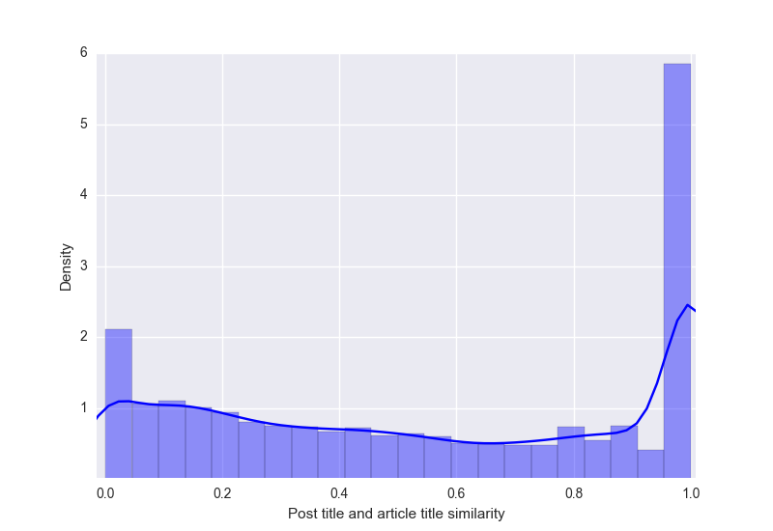
Reddit Users Change Most Headlines
85% in 2012
71% in 2013
Title Cosine Similarity
Title Cosine Similarity
Notes:
Relabel, mention cosine similarity

Slide 17
Inspect Headline Change with Wilcox Rank Sum
Hypothesis testing on title similarity using the same two class divide
Hypothesis testing on feature distributions of title pairs with similarity less than 0.1

Slide 18
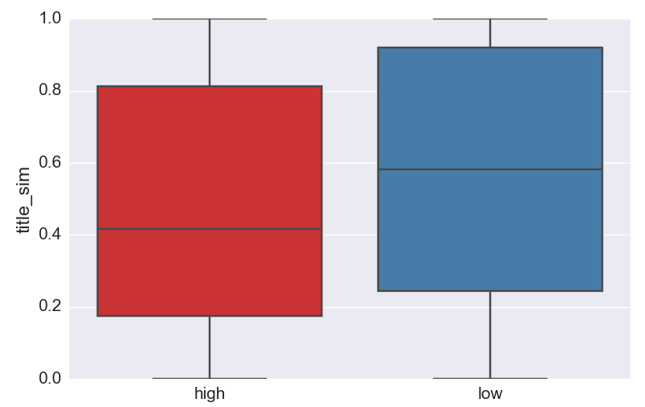
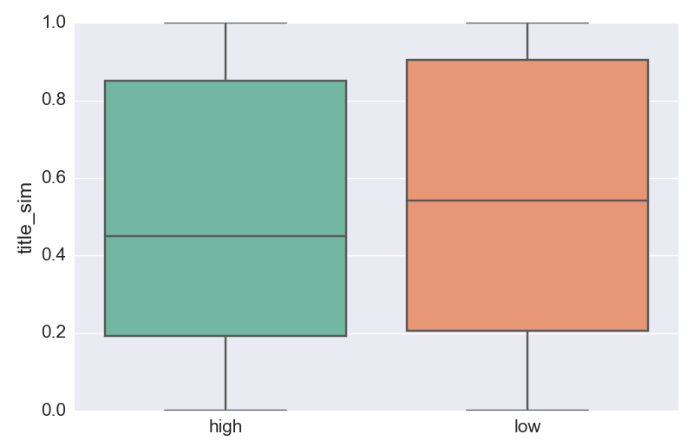
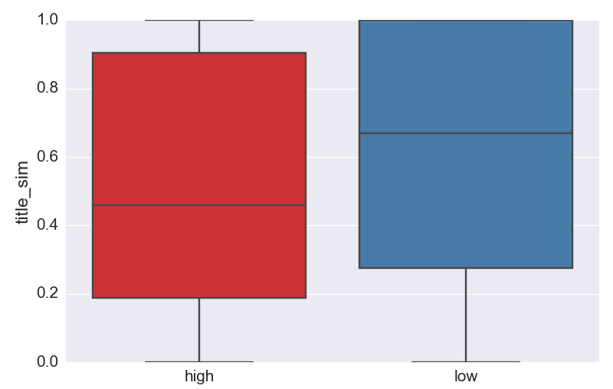
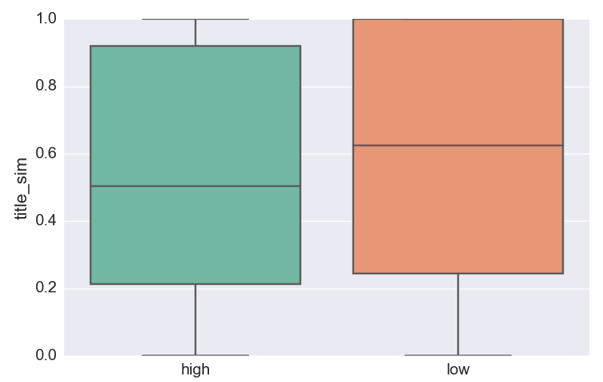
Changed titles tend to be slightly more popular
Popularity
Engagement
Popularity Engagement
2012:
Wilcoxon P-Value 7.73e-05 8.40e-05
Effect Size 0.1557 0.1439
Grissom-Kim Prob 0.55 0.53
2013:
Wilcoxon P-Value 8.19e-11 1.11e-13
Effect Size 0.1368 0.1256
Grissom-Kim Prob 0.54 0.51
Title Similarity
High class
Low class
High class
Low class

Slide 19
Original titles are significantly shorter, more negative than changed titles
Feature | 2012 | 2013 | Avg. Effect Size
Positive Emotion | Changed > Original | Changed > Original | 0.0507
Vader Positive Score |  | Changed > Original | 0.0678
Positive Strength |  | Changed > Original | 0.2147
Negative Emotion | Changed < Original | Changed < Original | 0.1497
TTR (Lexical Diversity) | Changed > Original |  | 0.1448
Affect | Changed < Original |  | 0.0922
Tone |  | Changed < Original | 0.1001
Swear | Changed > Original | Changed > Original | 0.0154
Informal | Changed > Original |  | 0.0705
Word Count | Changed > Original | Changed > Original | 0.4457
Readability | Changed > Original | Changed > Original | 0.3416
Avg Word Length | Changed > Original | Changed > Original | 0.1595
Notes:
Redo table

Slide 20
Original
Changed
China's State Press Calls for 'Building a de-Americanized World'
"China's State Press: ""The goal is to create an international reserve currency that is disconnected from individual nations and is able to remain stable in the long run."""
U.S. Raids in Libya and Somalia Strike Terror Targets
U.S. Navy SEALs Raid Somali Militants Responsible for Nairobi Mall Attack - Leader Killed (unconfirmed)
Southern Weekly reporters confront China censors
Journalists at a leading Chinese newspaper have called for a propaganda chief to resign in a rare protest against censorship.
Egypt troops clear Morsi protests: Wednesday August 14 as it happened
Sky News cameraman Mick Deane shot dead in Cairo

Slide 21
Presented preliminary findings of popularity and engagement of news on reddit
Many previous findings about news popularity still hold true on reddit
We can predict popularity and engagement despite many confounding factors
Commenting and Voting may be motivated differently
Crowds also curate titles to make them more engaging to the community
Notes:
Popularity and engagement have potentially different motivations. Popularity on reddit same as online news in general.

Slide 22
There is much more work to do
US vs World
How does news popularity and engagement hold across platform/user groups?
User studies to understand motivation of voting and commenting on news
Do these findings change over time?
Notes:
Fake news is more relevant, US and world are different in discussion, understand deeper how title is changed (which arguments are picked from the article), loop it together, close the workshop

Slide 23

Benjamin D. Horne
Twitter: @benjamindhorne
Data: github.com/rpitrust/reddit-scraped-worldnews-dataset
Thanks to Sibel Adali

